Slide 1



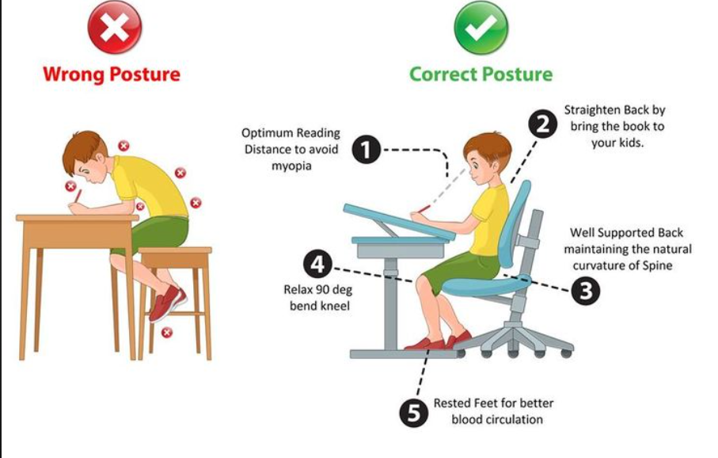
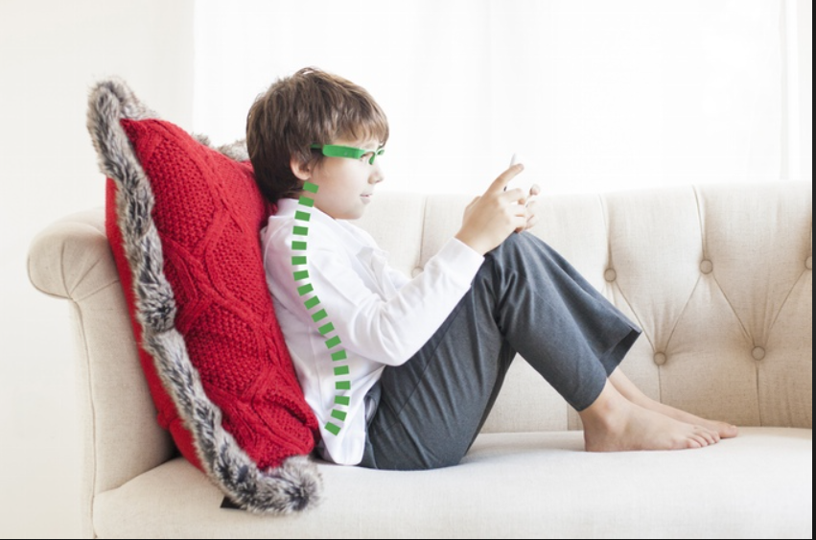
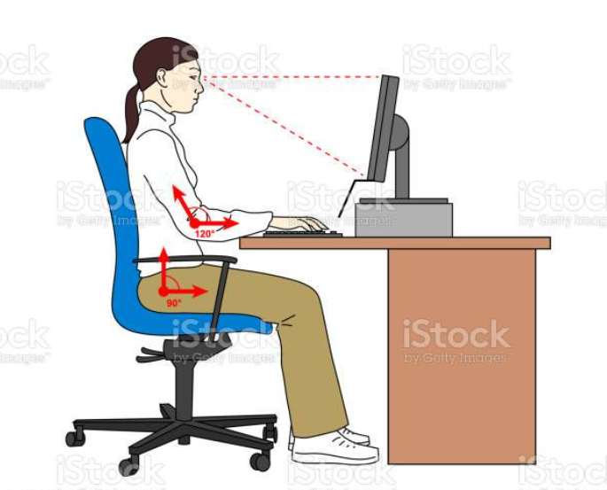
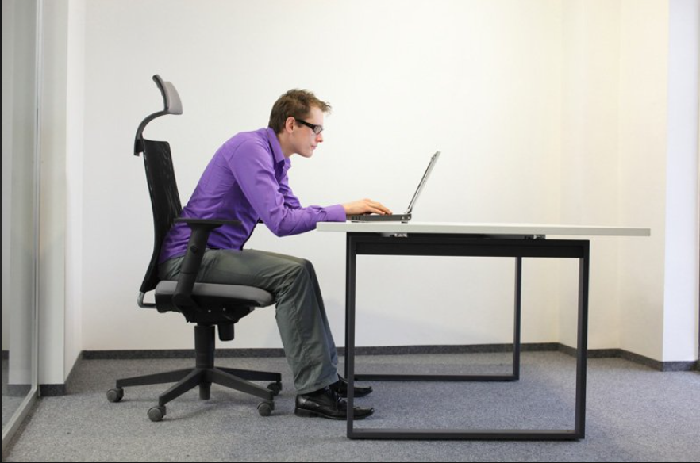
Wearable posture monitoring system

Slide 2
AIM :
To create a comfortable and accurate wearable posture monitoring system sensor that provides real-time feedback and analysis to help individuals improve their posture and prevent posture-related health issues.
OBJECTIVE :
The objective of making a wearable posture monitoring system is to help individuals improve their posture and prevent musculoskeletal problems caused by wrong posture. wrong posture can lead to back pain, neck pain, and other physical issues that can impact an individual's overall health and wellbeing. A wearable posture monitoring system can track an individual's posture throughout the day and provide feedback to help them correct their posture. It can also provide reminders to stand up and move around periodically, which can help reduce the risk of developing health issues associated with sitting for long periods of time. Overall, the objective of a wearable posture monitoring system is to promote good posture and help individuals maintain a healthy lifestyle.

Slide 3
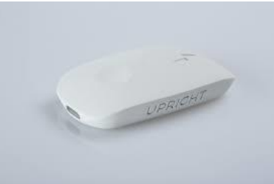
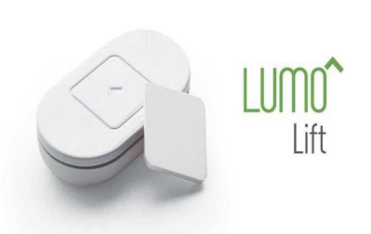
❖ ABSTRACT:
Already available devices:
• Upright go:
Lumo Lift:

Slide 4
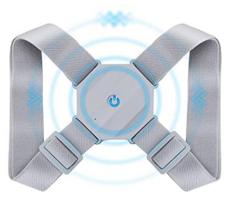
Posture keeper :
DRAWBACKS OF ALREADY AVAILABLE DEVICES:
Drawbacks of Upright GO wearable posture monitoring sensor:
The Upright GO is a popular wearable device that is designed to help individuals improve their posture by monitoring their sitting position and alerting them when they slouch or hunch over. While this device has many benefits, there are also some potential drawbacks to consider:
Limited accuracy: The Upright GO is not 100% accurate in detecting sitting posture. It relies on a single sensor to detect the position of the device, which may not always accurately reflect the user's actual posture.

Slide 5
Requires consistent use: To get the full benefits of the Upright GO, users need to wear the device consistently throughout the day. This can be challenging for some individuals who may find it uncomfortable or forget to put it on.
Battery life: The Upright GO has a limited battery life and needs to be charged frequently. This may be inconvenient for users who have to take breaks to charge the device during the day
Incompatible with some clothing: The Upright GO is designed to be worn on the upper back and may not be compatible with certain types of clothing, such as tight-fitting shirts or dresses.
Limited feedback: While the Upright GO can alert users when they are slouching, it does not provide detailed feedback on their posture or suggest specific exercises to improve it. Users may need to seek additional resources or guidance to improve their posture effectively.
Overall, the Upright GO can be a useful tool for improving posture, but users should be aware of its limitations and be willing to commit to consistent use to see results.

Slide 6
2. Drawbacks of Lumo Lift wearable posture monitoring sensor:
The Lumo Lift is another popular wearable device that is designed to help individuals improve their posture by monitoring their sitting position and alerting them when they slouch or hunch over. While this device also has many benefits, there are some potential drawbacks to consider:
Limited accuracy: The Lumo Lift, like the Upright GO, is not 100% accurate in detecting sitting posture. It relies on a single sensor to detect the position of the device, which may not always accurately reflect the user's actual posture.
Requires consistent use: To get the full benefits of the Lumo Lift, users need to wear the device consistently throughout the day. This can be challenging for some individuals who may find it uncomfortable or forget to put it on.
Battery life: The Lumo Lift has a limited battery life and needs to be charged frequently. This may be inconvenient for users who have to take breaks to charge the device during the day.
Incompatible with some clothing: The Lumo Lift is designed to be worn on the upper body and may not be compatible with certain types of clothing, such as tight-fitting shirts or dresses.
Limited feedback: While the Lumo Lift can alert users when they are slouching, it does not provide detailed feedback on their posture or suggest specific exercises to improve it. Users may need to seek additional resources or guidance to improve their posture effectively.

Slide 7
Potential discomfort: Some users may find the Lumo Lift uncomfortable to wear, particularly if they have sensitive skin or are not used to wearing wearable devices.
Overall, the Lumo Lift can be a useful tool for improving posture, but users should be aware of its limitations and be willing to commit to consistent use to see results. They may also need to seek additional resources or guidance to improve their posture effectively.
3.Drawbacks of posture keeper wearable posture monitoring sensor:
Limited size range: The Posture Keeper smart T-shirt is currently only available in a limited range of sizes, which may not fit all users comfortably or provide accurate posture monitoring.
Requires charging: The T-shirt includes a small, rechargeable device that must be charged regularly, which may be inconvenient for some users.
Limited functionality: The Posture Keeper T-shirt is primarily designed for posture monitoring and may not include additional features, such as activity tracking or coaching.
Reliance on smartphone app: The T-shirt's posture monitoring and feedback rely on a smartphone app, which may not be convenient or accessible for all users.
Price: The Posture Keeper T-shirt is more expensive than some other posture monitoring devices, which may make it less accessible for some users

Slide 8
❖ CURRENT SCENARIO:
Posture is the way people carry themselves, and this posture has a substantial effect on their health particularly on our spinal cord which ultimately leads to back pain mainly due to over usage of computers, laptops and smartphones. In survey analysis we have recognized that the existing systems are having some drawbacks such as their sensor selection is not satisfied, in some cases, they lack portability and small profile module. To overcome these problems, we have designed a module by using Arduino software which indicates the user by gentle vibration / LED glow whenever he/she bends. The result will be indicated in four cases such as bending towards front, back, right and left. As conclusion this system will help the user to feel comfortable to wear and free to carry the module wherever he/she wish and we hope that the user can correct his/her posture by their own and later they used to maintain a proper posture
❖ OUR DEVICE WILL COVER FOLLOWING DRAWBACKS:
Accuracy
Compatible with all types of clothing
Less cost
We are adding both vibrations and LED lights
Better lifetime than above devices

Slide 9
❖ MEDICAL REVIEW ON SITTING POSTURE:
Wrong posture is a common problem, with a significant portion of the population experiencing some degree of discomfort or pain due to it. According to some estimates, up to 80% of people may experience back pain at some point in their lives, which can be attributed to poor posture among other factors. Additionally, with the changes in work and lifestyle brought about by the COVID-19 pandemic, there has been an increase in the number of people experiencing body posture problems.
Pre-COVID-19 Body Posture Problems:
• People who spent long hours sitting at a desk or in front of a computer had posture problems related to hunching over or slouching.
• People who had physically demanding jobs, such as manual laborers, had posture problems related to lifting or repetitive motions.
• People who frequently travelled for work may have had posture problems related to sitting for long periods on planes or in cars.
Post-COVID-19 Body Posture Problems:
• People who began working from home developed posture problems related to working on a laptop at a kitchen table or on a couch, rather than at a proper desk and chair.
• People who were unable to go to the gym or engage in their usual physical activities developed posture problems related to decreased movement or exercise.

Slide 10
• People who experienced COVID-19 symptoms or were hospitalized developed posture problems related to extended periods of bed rest or immobility.
❖ BLOCK DIAGRAM
SENSOR
SIGNAL AMPLIFICATION
MICRO-CONTROLLER
OUTPUT
COMPUTATION
DATA-TRANSFER

Slide 11
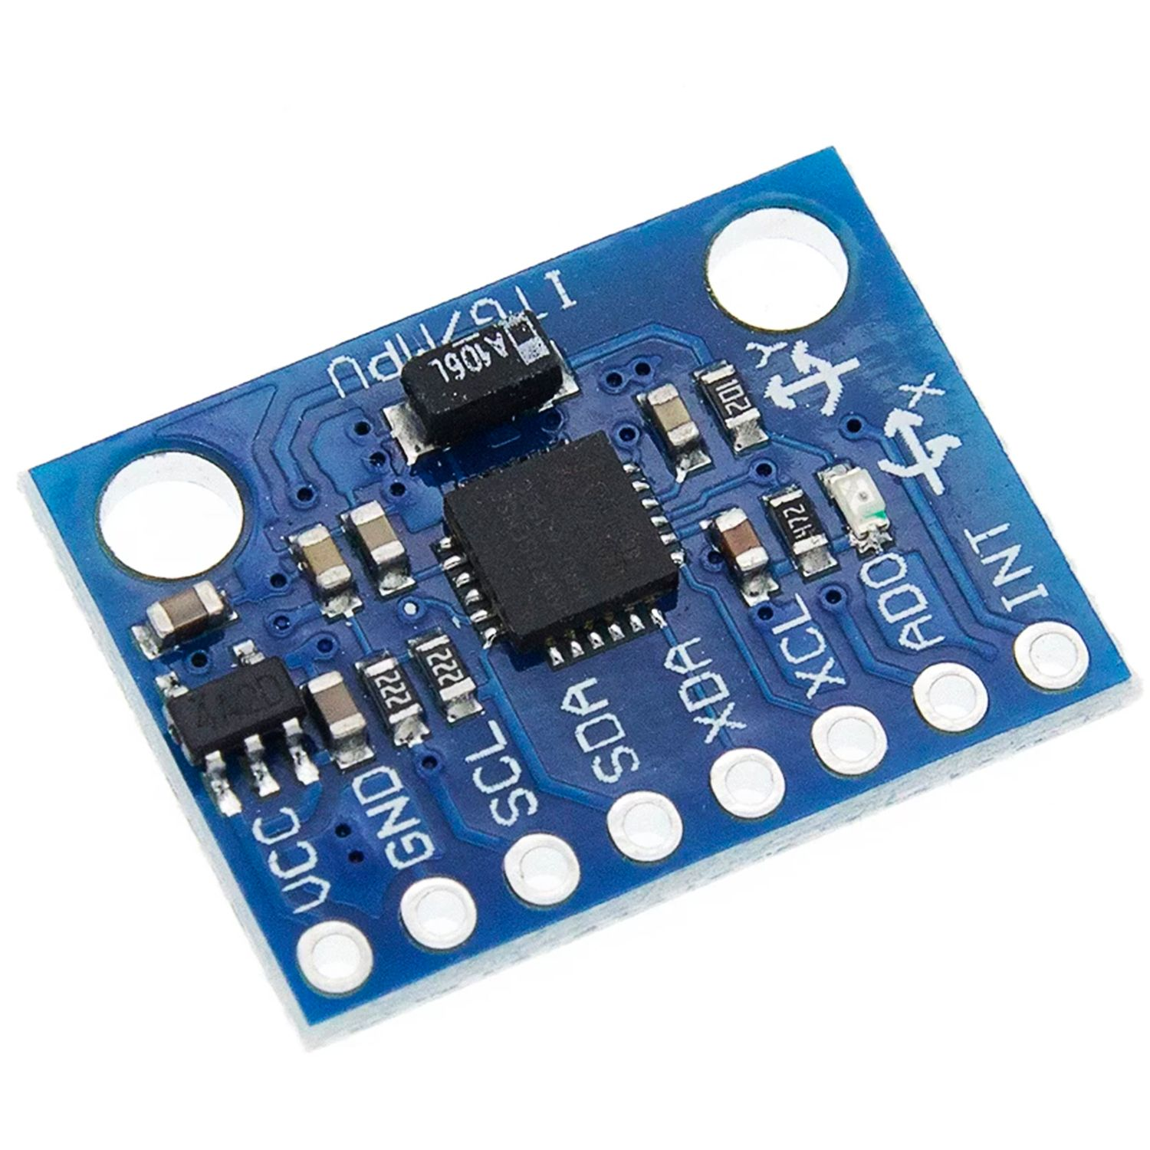
COMPONENTS AND METHODS :
COMPONENTS :
This model is developed using the Hardware Components – MPU6050, push button,Amplifier, Arduino Nano and LED and Software Components - Arduino IDE.
SENSOR : MPU6050
The MPU6050 sensor is used to read the current position user as the digital value. It comprises of 3-axis gyroscope and 3-axis accelerometer. The MPU6050 sensor is used to read the current position user as the digital value. It comprises of 3-axis gyroscope and 3-axis accelerometer as shown in Fig. 1.This will enable the sensor to check the orientation of the spinal cord in all the 3-axis. It measures both the axis and the angle of the spinal cord movement.

Slide 12
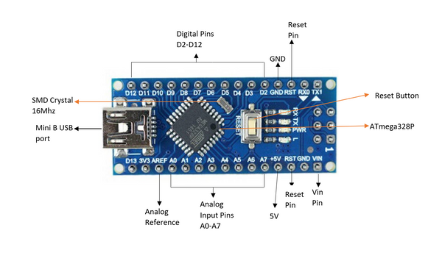
2. AMPLIFIER :
The signal that is produced from the sensors is generally very weak, sometimes in terms of microamps. Such signals need amplification so that they can be used for signal processing. Op-Amps are generally used to carry out this process.
3. MICROCONTROLLER : ARDUINO NANO
The microcontroller used for the system is the Arduino Nano . 2. It is mainly chosen for its small profile which is helpful for space reduction, weight and it is same as Arduino Uno and it is cost efficient and it is very helpful in prototyping with PCB.
4. OUTPUT : LED, /VIBRATOR

Slide 13
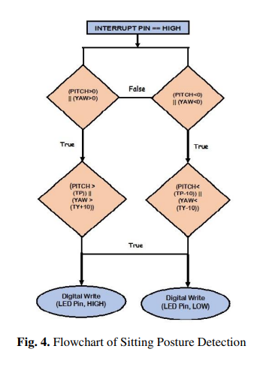
METHODOLOGY :

Slide 14
CONCLUSION :
Most of the methods which has been used in the existing systems are not that much portable, wearable and they seem to be bulky. By the above proposed device, sitting posture along with neck posture is also monitored and we have improved the system into small profile, wearable and ease to carry every place. This will improve their health and prevent them from various spine related diseases. We have used Arduino software for the development of model and we have used single sensor for tracking the spinal cord position and the user will be indicated by LED glow later it can be replaced with vibrator and in future development we can connect the device to mobile by means of Bluetooth for tracking our posture daily. We hope that our proposed system will help to correct and maintain the user‘s spinal cord posture and especially we believe that IT employees will be benefited a lot.

Slide 15
THANK YOU !
SHETA HADHAV – 112109014
JANYAA TIKOO – 112109015
GANGASAGAR LONEKAR – 112109021
ATHERV NEGLUR - 112109025

